Slide 1
Shenandoah Valley Wastewater Treatment Plant Network
Selecting and Implementing a Successful SCADA System
SVWWPTN – Verona, Va
TJ Johnson – Delta Systems Environmental

Slide 2
Selecting and Implementing a Successful SCADA System - Course Outline
Prologue…
1- What is SCADA?
2 – SCADA System Components
3 – SCADA For Your System
4 – SCADA System Planning
5 – SCADA System Selection
6 - Questions

Slide 3
June 2012 - Readers Digest – Top 10 Jobs Americans Can’t Live Without
# 2. Water/Wastewater Plant and System Operators
Water and Wastewater System Operators - Number Employed: 108,330, Median Income: $40,770, Water and waste water systems require near-constant supervision in order to ensure that systems are safe and reliable. As a result, system operators must either work or be on call at all hours. Plants and systems are highly regulated and can face a number of problems. Storms can cause flooding in sewers, and water can be tainted by chemicals.
# 1?
Nurses

Slide 4
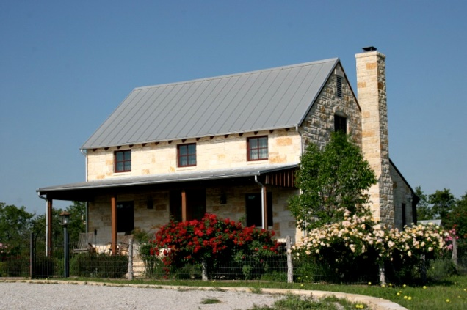

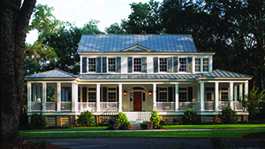

Imagine You Need a New Home…
So you go to a realtor and buy this…

Slide 5
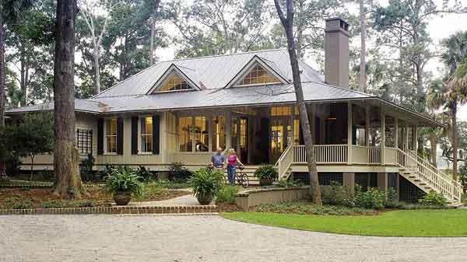

Slide 6
Nice Home? Southern Living Winner!
…You drive a diesel truck and the only fuel is 11 miles NW
Room for in-laws?
Too much shade for a garden
Drummer, but no shed
No garage or barn
3 bedroom, you have 3 children and one more on the way
Work is 14 miles to the SE…
No fence, yet you have 2 dogs

Slide 7
Key takeaways from this class…
It’s your system, you and your team know it better than anyone else
A SCADA system works best if it works for you
Best system for you requires…
…planning
…team input
…anticipation of future growth ?5 years, 10 years?

Slide 8
Congratulations! We Did It…
Right now, we can monitor any sensed parameter from anywhere we are…
How? With a Combination of…
Sensor output and sensor reliability, data transmission, the internet, cellular technology and smart displays
Future improvements…

Slide 9
1- What is SCADA?
S – Supervisory
C – Control
A – And/or
D – Data
A – Acquisition

Slide 10
Data Acquisition at it’s simplest
Fwd: Sept 25, 2019
Total - 93,434 × 10 gal
Max – 1,274 gpm
Min - 0 gpm
Sent via text from a flow meter with a SIM card
20 Cents per text – or about $6.00 per month

Slide 11
And more complex…
In a storm caused power outage you are monitoring your booster stations…
  …Fuel levels in your generators
  …From your house
Prior to the storm…
  …You tested each generator power transfer capabilities
  …From a restaurant via your smartphone

Slide 12
2 – SCADA System Components
Made up of multiple parts, but not always complex parts
Sensor & Transmitter
Remote Field Device
Communications Device
Computer System
HMI – Human Machine Interface
Alarm System – Key Component!
Remote Access to the System

Slide 13
3 – SCADA System Capabilities
At Booster Stations…
Well Levels
Pump Run Status
Pump Status – Power Usage
Flow Input & Output – Wells have limits, leaks, etc
System Pressure
SCADA System Power
Generator Status
Generator Fuel Level
Site Security – Water Tower Protection

Slide 14
4 – SCADA System Planning
Begins with you and your team!!!
It’s your system and you know it better than anyone…
What do you and your team need to know, when do you need to know it, who needs to know and where do they need to know it…
Do you need a consultant?
What are others monitoring? Ask around!
Where will the system be housed?
Alarms are key – indication of what’s wrong!

Slide 15
SCADA Security!!!
Current systems are very secure…
Implement best practices, training…
What is your nightmare scenario?
Ask – What are we risking?
Ask - What is being monitored and controlled?
Ask - Is simple monitoring and alarming enough?
Know that the biggest threat is from within your own system! Change passwords!
Secure your system – isolate it!

Slide 16
5 – SCADA System Selection
Ask – What do you want your system to do?
Two types – Sole Sourced and Integrated
Pros and Cons to both systems
Ask around!!! What are others using and are they satisfied with it?
Good and bad systems exist!
What do you want to do? Turn-key? Hands-on?
Training?
Expansion?
Future technology integration?
Cost of ownership?

Slide 17
“Ask Julie, she knows…”
“I’m old school, I don’t need to know the new trends…”
Your dentist
“New fangled stuff is not needed in my line of work…”
Heart surgeon
“Technology is for the up and comers…”
Airline Pilot
Readers Digest - # 2 needed profession in the USA.

Slide 18
Questions???
            Thanks!

