Slide 1
Odor and Corrosion Control
Chemistries in the
Collection System
By: Tim McComas
George S. Coyne Chemical Co., Inc
Environmental Services Group
Croydon, PA 19021
tmccomas@coynechemical.com
215-817-5306 (cell)

Slide 2
Company Overview
Coyne Chemical
  146 years of chemical distribution
  Full line chemical distributor
    Water , Wastewater, and Groundwater Remediation
    Supply most chemicals discussed
  Distribution facilities
    Paterson NJ, Croydon PA, Reading PA, Morrisville, PA
  Technical support and Lab services

Slide 3
Overview
Commonly Found Odors
Major Problem:
  Hydrogen Sulfide (H2S)
Why control H2S?
How to monitor H2S
Solutions to Controlling
  Hydrogen Peroxide
  Chlorine
  Potassium Permanganate
Solutions to Controlling (cont):
  Ferrous Chloride
  Ferrous Sulfate
  Sodium Hypochlorite
  Carbon Scrubbers
  Alkalinity Adjustment
  Endimal ® Series
  Calcium Nitrate

Slide 4

Odors in the Sewer System
NAME FORMULA CHARACTERISTIC ODOR THRESHOLD
(ppm)
Hydrogen Sulfide H2S Rotten eggs 0.00047
Ethyl Mercaptan CH3CH2-SH Decayed Cabbage 0.00019
Methyl Mercaptan CH3-SH Decayed Cabbage 0.0011
Dimethyl Sulfide CH3-S-CH3 Decayed Vegetables 0.0001
Sulfur Dioxide SO2 Pungent, Irritating 0.009
Benzyl Mercaptan C6H5CH2-SH Putrid – Unpleasant 0.00019

Slide 5
Problem: Hydrogen Sulfide
Hydrogen Sulfide (H₂S) found in two forms
  Insoluble Sulfides
  Dissolved Sulfide
    Causes odor complaints and destruction of facilities
H₂S evolves in the following ways:
  Found directly in wastewater flows – placed there by industrial or groundwater contributions. Not often the case
    Demand customer remove the sulfide
  More often H₂S evolves from biological activity
    Bacteria reducing inorganic sulfur compounds

Slide 6
The Collection System
What is the function of sanitary sewers?
  Collection and transport of wastewater to the treatment plant
  Sewers are large biological reactors (…whether we like it or not).
Biological processes in sewers
  Good biofilms: wastewater treatment
  Bad biofilms: plaque
  Influence on biofilms
Notes:
The collection system has traditionally been viewed as a “means to an end” for the WWTP, however the biofilm in the sewer has similar treatment capability as a trickling filter if the microbiology can be harnessed.

Slide 7
Definitions
Aerobic | D.O. present
Anoxic | D.O. absent NOxN present NOxN= Nitrite-N + Nitrate-N
Anaerobic | D.O. absent NOxN absent

Slide 8
Sulfate Reduction in Sewer Biofilms
Sulfate (SO₄²⁻)
Sulfide (H₂S)
NO₃⁻
O₂
Aerobic
H₂S + O2 → SO₄²⁻
Sulfide oxidation
Aerobic
Anoxic
Anoxic
Anaerobic
SO₄²⁻ + org matter → H₂S
Sulfate reduction by sulfate reducing bacteria (SRB) under anaerobic conditions
Anaerobic

Slide 9
Effects of Hydrogen Sulfide
Odor nuisance and health related problems
Corrosion due to sulfuric acid formation
Autotrophic bacteria (e.g., Thiobacillus sp.) oxidize hydrogen sulfide to sulfuric acid (H₂S + O2 → H₂SO₄)
H₂S(g)
H₂S→H⁺+HS⁻

Slide 10
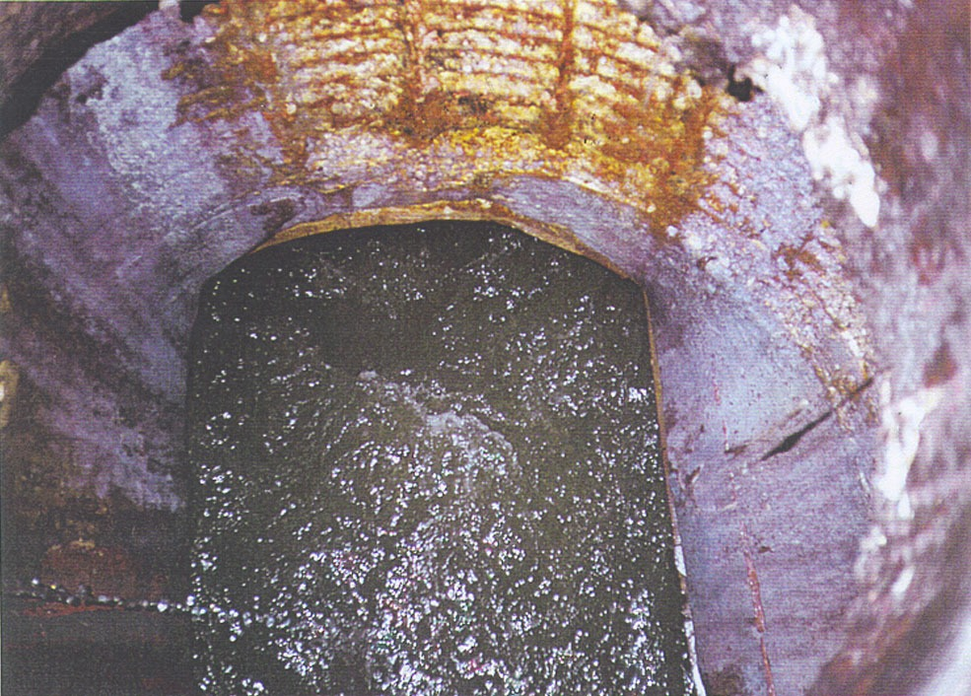
H₂S Formation
Factors Affecting H₂S Production
Oxygen Level
Wastewater Strength
(BOD)
Temperature
Turbulence
Slime Layer

Slide 11
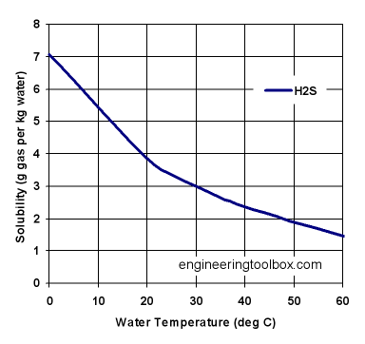

Henry’s Law
Henry’s Law: p = k_{H}c
Solubility & Temperature
Reaction Kinetics
Increased turbulence
H₂S_{(liquid)} H₂S_{(gas)}
Notes:
The next step is, how does the H2S in the water get into the air.
There’s a law called Henry’s which relates the partial pressure of a gas above a liquid to the concentration of solute in the liquid phase. So for example, as pH decreases and the H2S concentration in the wastewater increases, this will be followed by the increase of the partial pressure of H2S in the gas phase according to Henry’s law.
And as I mention before, the solubility of H2S in water also changes with the temperature of the wastewater. The solubility of H2S in water decreases with increasing temperature, releasing more H2S into the air.
Reaction Kinetics: Refers to the speed at a which a chemical reaction will take place. In general, the rate of a reaction increases with increasing temperature.
And lastly, the turbulence of the wastewater in the form of mixing or cascading flows of water will also contribute to the transfer of H2S from liquid to the gas phase. For example, Parkson’s Rotary Drum screens will contribute to more H2S being released due to agitation. This is something we’re currently trying to address at the Modesto, CA pilot and also something we may try to change in the actual design of the screens in order to incorporate an OHxyPhogg.

Slide 12
Why Control Hydrogen Sulfide?
Reasons for odor reduction
  Safety of employees of sewer authorities
  Nuisance to people living in the general vicinity of waste treatment systems
  Financial cost
    Destructive to piping, instrumentation and buildings

Slide 13
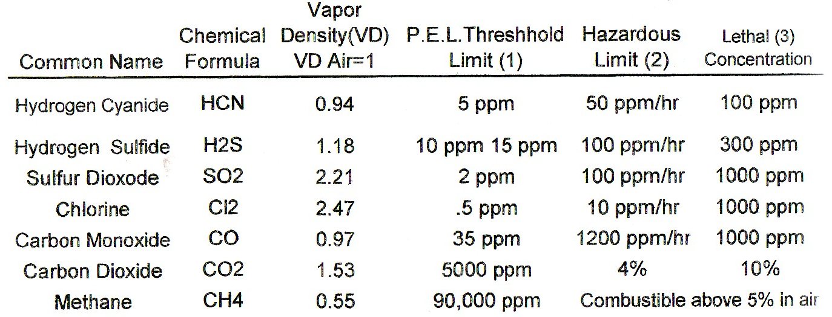
Toxicity

Slide 14
Physical Effects
Remember
1% = 10,000 Parts Per Million (PPM)
Concentration Physical Effects
Present (%) PPM Grains/100’ std ft 3(1)
0.000002 0.02 0.0013 Odor Threshold
0.000005 0.05 0.0031 Obvious and unpleasant odor
0.001 10 0.625 Safe for 8 hours exposure
0.01 100 6.48 Kills smell in 3 to 15 minutes
may sting eyes and throat
0.02 200 12.96 Kills smell shortly; stings
eyes and throat

Slide 15
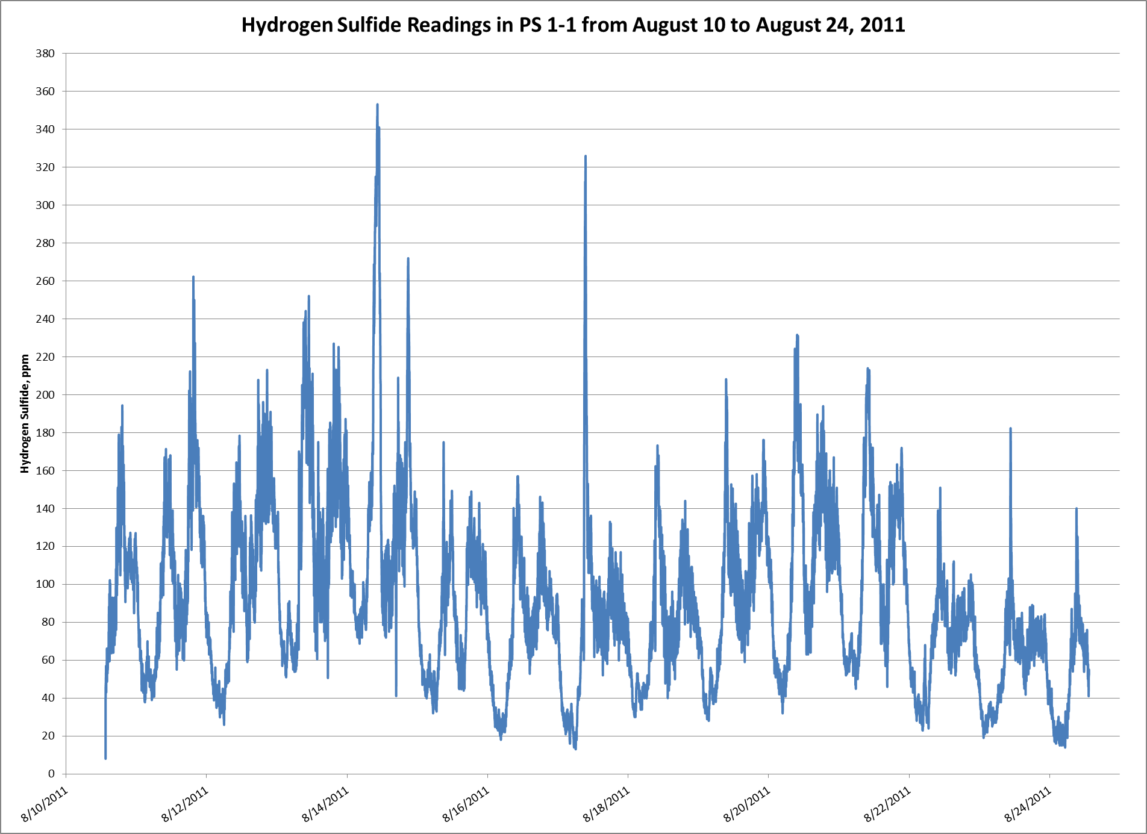

Slide 16
Why Control Hydrogen Sulfide
    Hydrogen Sulfide can be destructive to piping, instrumentation and buildings
    Typically accompanying a point of agitation, hydrogen sulfide is oxidized and forms sulfuric acid
Formation of Sulfuric Acid is main cause of:
  Crown corrosion
  Pipe failure
  Other destructive measures
Humidity in pump stations and waste treatment processes sufficient to cause the formation of sulfuric acid
  May destroy electrical controls if not properly protected

Slide 17
During the past 25 years regulatory changes have fundamentally altered the physical, chemical and biological properties of municipal wastewater.

Slide 18

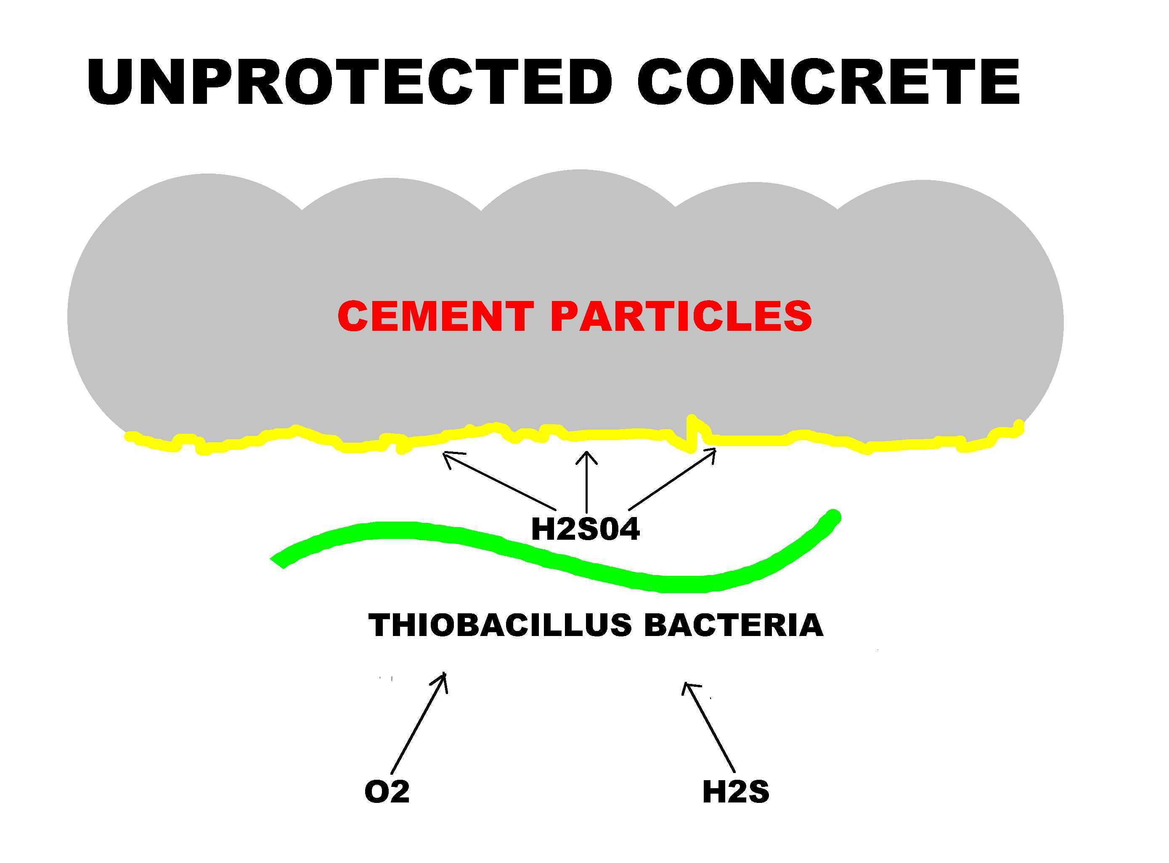
AP/M PERMAFORM

Slide 19
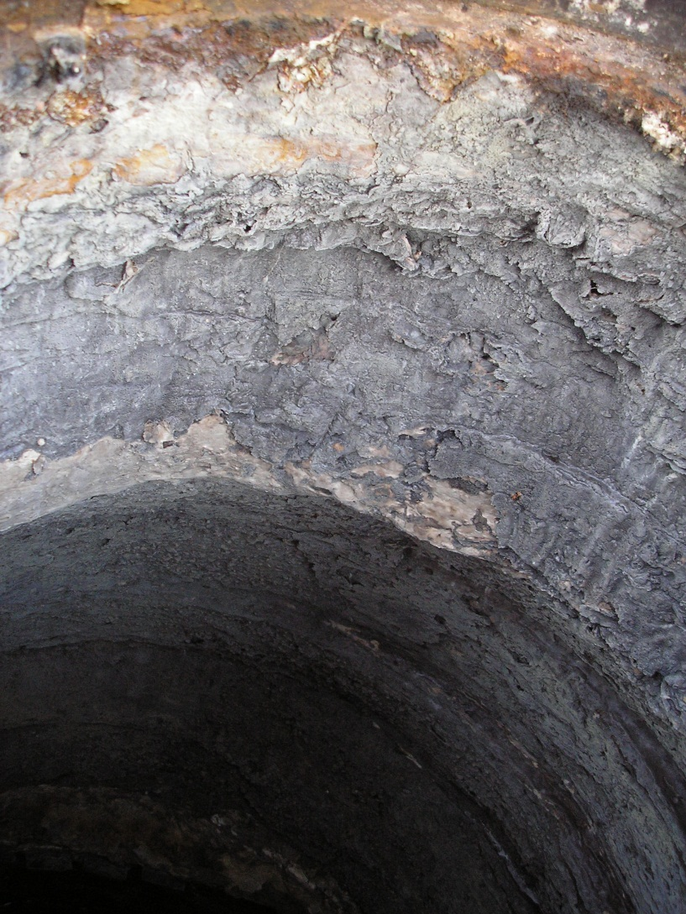
Hydrogen Sulfide
What’s it doing to my collection system?
Sulfuric acid reacts with concrete forming calcium sulfate – essentially wet wall board!

Slide 20
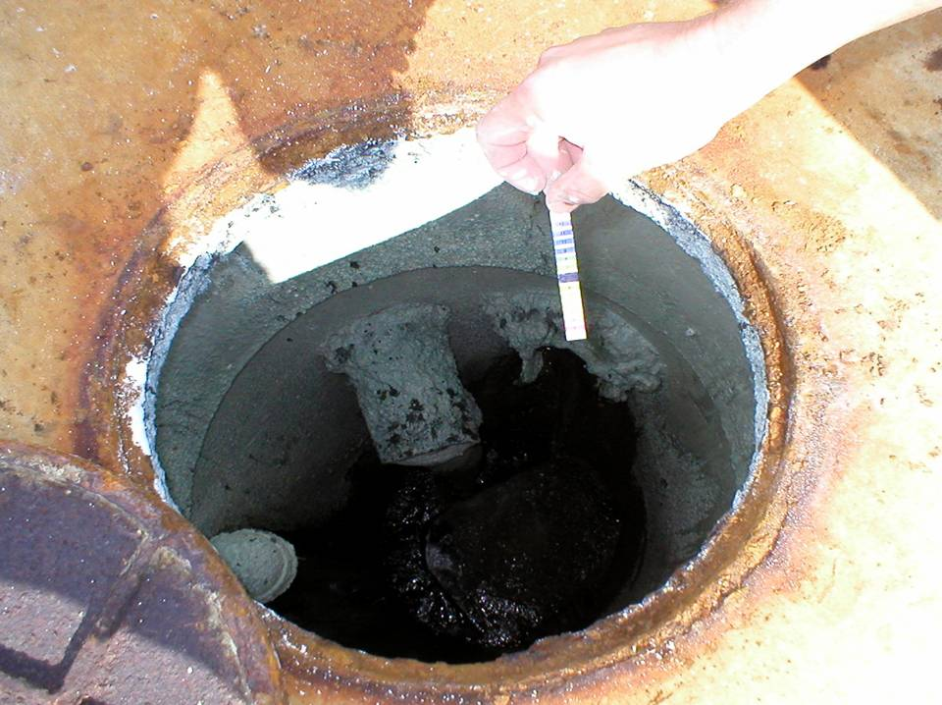
Surface pH
tells the whole story…

Slide 21
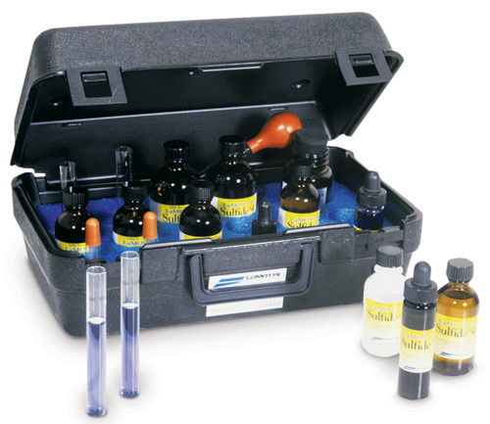
How to Monitor Hydrogen Sulfide
Lamotte Sulfide Test Kit (LaMotte Pomeroy Method)
    Total Sulfides (accurately measures 0-18.0 PPM)
    Dissolved Sulfides
Notes:
Remember that grab-sampling is just a snapshot of a moment in time, but still a useful tool in a trial.
The LaMotte is a very accurate, effective and easy-to-use field kit.
There are other kits for this purpose out there, but we have used this one for 30+ years with great success.

Slide 22

How to Monitor Hydrogen Sulfide
OdaLog Logger
Continual vapor phase monitoring
Notes:
The L2 is the workhorse of the OdaLog line, their base model.
Parameters can be easily set for desired frequency of the air samples via an infrared connection and a PC.
Logging intervals can be set from 1 second to 1 hour, and everything in-between.
Our units measure up to 200 PPM. There are other devices available with a range up to 1000 PPM.

Slide 23
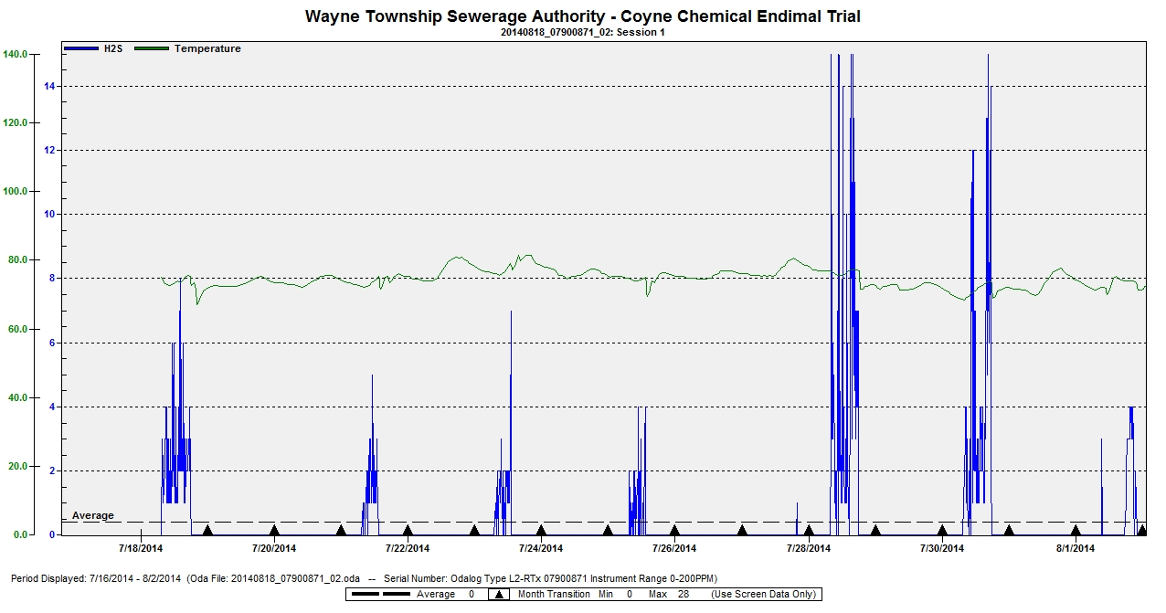
How to Monitor Hydrogen Sulfide
OdaLog Logger
Continual vapor phase monitoring
Notes:
The L2 is the workhorse of the OdaLog line, their base model.
Parameters can be easily set for desired frequency of the air samples via an infrared connection and a PC.
Logging intervals can be set from 1 second to 1 hour, and everything in-between.
Our units measure up to 200 PPM. There are other devices available with a range up to 1000 PPM.

Slide 24
Solutions to Controlling Hydrogen Sulfide
Vapor Phase
  Chemical
  Scrubbers
    Bioscrubber
    Biofilters
    Chemical
Liquid Phase
Chemical
Biological

Slide 25
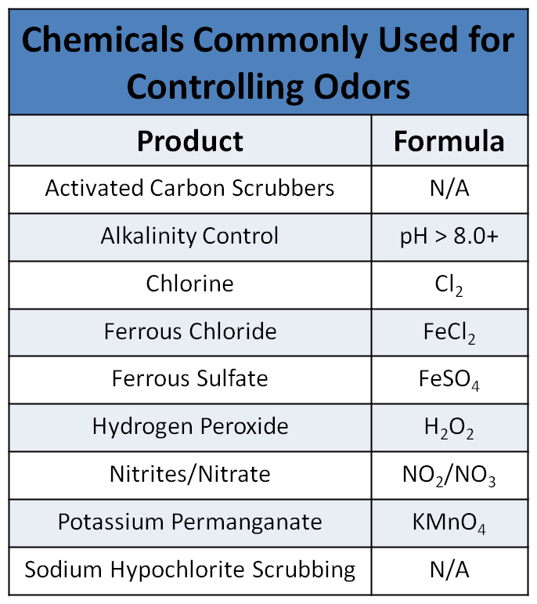
Solutions to Controlling Hydrogen Sulfide

Slide 26
Solutions: Hydrogen Peroxide
The Mechanism by which Hydrogen Peroxide reacts with Hydrogen Sulfide is basic:
  Easily fed via metering pump to a point of application: 10 – 15 minutes detention time
  Better for collection systems, not sludge
H₂S + H₂0₂ → 2H₂0 + S
Based upon the chemistry, it would take two parts of 50% Hydrogen Peroxide to reduce one part Hydrogen Sulfide
  Actual conditions experienced in the field show a 3:1 ratio is more realistic
  Unique property: reduces slime layers present on pipe walls
  Overdosing of Hydrogen Peroxide does not cause adverse effects
    Only problem caused is potentially expensive
    Overdose situation yields supplemental dissolved oxygen, benefits downstream locations
Notes:
Water and Sulfur

Slide 27
Solutions: Hydrogen Peroxide
Pros:
  Easy to apply
    Systems provided by product supplier
    Low Freeze Point
  Reacts preferentially with Hydrogen Sulfide
  Actual Dosage:
    1-2:1 (100% Basis)
    2-4:1 (50% Basis)
  No harmful side effects from overdosing
  Overdosing yields additional D.O.
Cons:
  Strong Oxidizer
  Reaction time may be problematic
    10-15 minute reaction time
  Potentially costly if not applied and monitored properly
  Effectiveness limited to detention times
    Over 4 hours multiple injection points may be needed
  Multiple feed points may be required

Slide 28
Solutions: Ferrous Chloride
One of two primary iron salts used to reduce Hydrogen Sulfide
  Early indications show outstanding results on long detention lines
H₂S + FeCl₂ → FeS(s) + 2HCl
  Reaction: disassociation of the iron molecule, which reacts with the sulfide
  Forms an insoluble iron sulfide which is then reduces to elemental sulfur
  Iron also reacts with phosphorus for the removal of phosphorus pollutant as well
Side Effects:
  Oxygen removed from the system (during the reaction) further enhances anaerobic conditions downstream
  By forming insoluble's, iron salts enhance sludge volume formation.
  Overdosing may drop the pH significantly
Notes:
Ferrous Sulfide and Hydrochloric Acid

Slide 29
Solutions: Ferrous Chloride
Pros:
  Easy to handle
    Liquid
    Low freeze point (-15 to -30F)
  Reacts relatively quickly
  Able to work over long detention lines
  Low dosage rates
  Removes phosphorous
  Low product cost if purchased in bulk
  Contains twice the active ingredient (Fe) than Ferrous Sulfate
Cons:
  Reducing agent using O₂ thus enhancing anaerobic conditions
  Adds considerable solids
    Adds sludge handling costs
  My contain toxic or restrictive levels of heavy metals
  Forms acid byproducts thus lowering pH

Slide 30
Solutions: Ferrous Sulfate
One of two primary iron salts used to reduce Hydrogen Sulfide
  History of beneficial results under certain conditions
  While no time frame has been found, its ability to work in long runs is questionable
H₂S + FeSO₄ → FeS(s) + H₂SO₄
  Similar to Ferrous Chloride, it behaves as a reducing agent … promotes the extraction of oxygen from the system, enhancing anaerobic conditions
  Coupled with suppressing the pH, makes for a questionable application
  Current thinking is if detention times are kept to a minimum, may be an economic alternative
Additional detraction:
  Heated storage
  Additional application equipment in colder climates
Notes:
Ferrous Sulfide and Hydrogen Sulfide

Slide 31
Solutions: Ferrous Sulfate
Pros:
  Easy to handle
    Liquid
  Reacts relatively quickly
  Low product cost
  Removes phosphorous
Cons:
  Adds additional sulfates to the system … may reduce to sulfide
  Reducing agent using O₂ thus enhancing anaerobic conditions
  Does not work as well as other iron compounds over long runs
  Adds considerable solids
    Adds sludge handling costs
  May contain toxic or restrictive levels of heavy metals
  Forms acid byproducts
    lowers pH
  Crystallizes at cool temperatures

Slide 32
Solutions: Sodium/Calcium Nitrate
Not an oxidizer. Nitrates prevent the formation of Hydrogen Sulfide from the start
  Nitrates provide the bacteria required to form sulfides an alternative food source
Due to a food to biomass equation, effective dosage levels are difficult to ascertain
  Often, a gallon of nitrate solution contains between 2 – 3.5 lbs of NO₂/NO₃
Solutions are relatively low in concentration (store and pump large quantities)
  Small drums/totes not always practical
  Costs associated tend to be higher than other solutions
Notes:
Bacteria will not interact with the sulfates, reducing them to sulfides
Exact dosages may need to be determined by a full scale trial, conducted on site

Slide 33
Solutions: Calcium/Sodium Nitrate/Nitrite
Pros:
  Easy to handle liquid
  Relatively safe to handle
  Works well in long detention force mains
  Adds no additional chemical precipitates
  Calcium or Sodium based
  Low freeze point
Cons:
  Adds nitrates to waterways if overdosed
  Takes time to build up in the system
    Approx 3 – 5 days
  Does not react to changes in the system
  Does not reach low levels
    < 1.0 mg/L H₂S
  Can be converted in treatment plants to ammonia
  Does not reduce existing sulfides
  May require large storage capabilities
  Beware of byproducts

Slide 34
Solutions: Chlorine
The old standby for curing many wastewater industry ailments
  Very effective in oxidizing Hydrogen Sulfide
H₂S + 4Cl + 4H₂O → 8HCl + H₂SO₄
  Very quick reaction ( ~2 seconds) if good mix is present … important when trying to remove odors at their point source
  Downside to reaction speed means dosage rate increases almost twofold in most applications
Feeding into wastewater flow is dangerous and expensive:
  Ton Cylinders: scales, cranes, and chlorinators must be located at point of application
  For use near residential neighborhoods, chlorine gas is a hazard
    Less hazardous forms available (calcium hypochlorite/sodium hypochlorite), however associated costs much higher
Notes:
HCl – hydrochloric acid
H2SO4 – Sulfuric Acid

Slide 35
Solutions: Chlorine
Pros:
  Reacts rapidly
    <2 seconds
  Oxidizes other odorous compounds
    Ammonia, Mercaptans, etc.
  Available in other forms
    Calcium Hypochlorite
    Sodium Hypochlorite
Cons:
  Spills or leaks may result in chlorine gas emissions
  Gas feed equipment is expensive
  Reacts with many compounds
    Actual dosage 10 – 15:1
  Toxic to beneficial biological organisms
  Reactions form acidic compounds which lower pH

Slide 36
Solutions: Potassium Permanganate
Strong oxidizer which has gained considerable acceptance as an odor control agent
  Also oxidizes other odorous compounds as well as other organic/inorganic compounds
H₂S + 2KMnO₄ → 2MnO₂ + H₂SO₄ + 2K
  Reacts almost instantaneously yielding manganese dioxide and sulfuric acid
  Further reduction takes it down to elemental sulfur
  Due to reaction speed, carful monitoring is necessary to minimize dosage/cost
Feeding requires:
  Dry Material Hopper type feeder
  Mixed into a solution (maximum 3%)
  Both are manpower intensive
Physical handling should be minimized to alleviate dusting
Notes:
Manganese Dioxide and Sulfuric Acid, Along with Potassium

Slide 37
Solutions: Potassium Permanganate
Pros:
  Quick reaction
  Oxidizes primarily H2S
  Works well in high solids waste streams (i.e. – sludges)
  Removes grease build-up in lines and wet wells
  Overdosing may provide small amounts of additional D.O.
Cons:
  Expensive equipment and maintenance required
  Requires operator attention to manually fill feed unit
  Creates dust hazard when handling
  Housekeeping and maintenance issues
  Costly if not monitored properly
  Reacts with other compounds
    Actual Dosage 6 – 9

Slide 38
Solutions: Sodium Permanganate
Strong oxidizer which is essentially the liquid version of potassium permanganate
  Also oxidizes other odorous compounds as well as other organic/inorganic compounds
    Can however lead to higher usage figures/costs
H₂S + Na₂MnO₄ → 2MnO₂ + H₂SO₄ + 2Na
  Reacts almost instantaneously yielding manganese dioxide and sulfuric acid
  Further reduction takes it down to elemental sulfur
  Due to reaction speed, carful monitoring is necessary to minimize dosage/cost
Supplied in 20% or 40% solution
Notes:
Manganese and Sulfuric Acid, along with Sodium

Slide 39
Solutions: Sodium Permanganate
Pros:
  Quick reaction
  Oxidizes primarily H2S
  Works well in high solids waste streams (i.e. – sludges)
  Removes grease build-up in lines and wet wells
  Overdosing may provide small amounts of additional D.O.
Cons:
  Costly if not monitored properly
  Must be handled carefully as it is a strong oxidizer
  Housekeeping and maintenance issues

Slide 40
Solutions: Alkalinity Adjustment
The amount of Hydrogen Sulfide present in the atmosphere is dependent on the pH of the originating waste stream
  Main concern is dissolved sulfides, not total sulfides
The more acidic the waste stream, the more likely it is to liberate Hydrogen Sulfide into the atmosphere
Alkalinity Adjustment can be used to limit the ability of the waste water stream to liberate Hydrogen Sulfide
  A pH of > 8.0 is required to limit hydrogen sulfide liberation
Slug dosing with alkaline materials does not affect the slime layer
  Highly effective in treating short lengths of pipe
  Slime will start to reestablish as pH approaches neutral … 10-14 days between re-dosing
Notes:
This method does not eliminate hydrogen sulfide, it merely alters the equilibrium
Severe turbulence and still allow liberation, even at a 9.0 pH

Slide 41

In water at pH 7
About 50% of the
dissolved sulfide
Converts to H₂S gas.
H₂S
H₂S
H₂S
H₂S Gas
H₂S Gas
H₂S Gas
SO₄²⁻
HS⁻
H₂S

Slide 42
Calcium and Magnesium Hydroxide Slurry
Pros:
  Relatively safe.
  Effective for long runs.
  Increases alkalinity along with pH.
  Adds no additional chemical solids.
  Helps remove grease build-up in lines and wet wells through saponification.
  Addition of divalent ion helps promote settling in clarifiers.
Cons:
  Requires mixing.
  Need a water source for flushing.
  More capital intensive than other chemical feed systems.
  Freezes at 32 degrees.
  Can be expensive.
  If magnesium hydroxide, be aware of struvite.

Slide 43
Solutions: Endimal SH
Newly developed liquid oxidizer formulated by Chemours Water Technologies (formerly DuPont)
Reduces Hydrogen Sulfide instantaneously upon complete mix
  Found to have great success in sludge handling applications
  Can replace potassium/sodium permanganate
    More effective at lower dosages
Easy to feed, must handle with care
  Suppliers have been well schooled in the design of the storage and feed system
  Reduces the handling aspects for the customer

Slide 44
Solutions: Endimal® Series
Pros:
  Easy to feed liquid
  Reacts instantaneously
  Oxidizes other odorous compounds
  Works well in high solids waste streams
  Low equipment costs
  Cost effective
Cons:
  Hazardous material
    Protective equipment required
  Not thought to be well suited for collection systems long retention times. Studies underway.
  Costly if not monitored properly

Slide 45
Cost Factors
In analyzing cost factors, it is difficult to draw a direct comparison
  Far too many variables affect the decision making process
  A product which may appear not the most cost effective may be the product of choice
  Trials are necessary to accurately determine product dosage and associated costs
Never a cure-all for ailments in the treatment process
Reputable suppliers should be able to demonstrate the cost effectiveness of their product to the end user
If possible, evaluate several different treatment methods prior to a decision

Slide 46
Questions?

